Slide 1
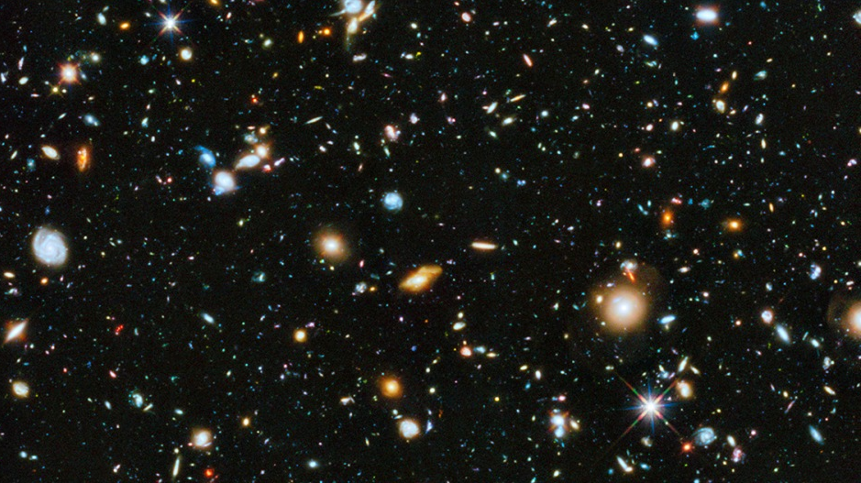
Cracking the Mysteries of the Universe
Dr Janie K. Hoormann
University of Queensland

Slide 2
Timeline of Cosmological Discoveries
1837: Bessel et al. measure distance to stars
1915: Einstein’s theory of general relativity
1929: Hubble measures expansion
1970: Dark matter in galaxies
16c BCE: flat earth
5-11c CE: Sun at the centre
1543: Copernicus’s heliocentric model
1905: Einstein’s theory of Special Relativity
4c BCE: Earth at the centre
1917-1922: Theorise universe is expanding
1933: Dark matter in the Coma cluster

Slide 3
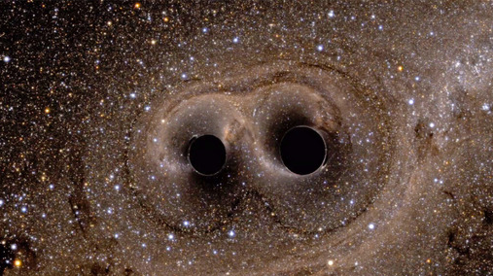
General Relativity

Slide 4
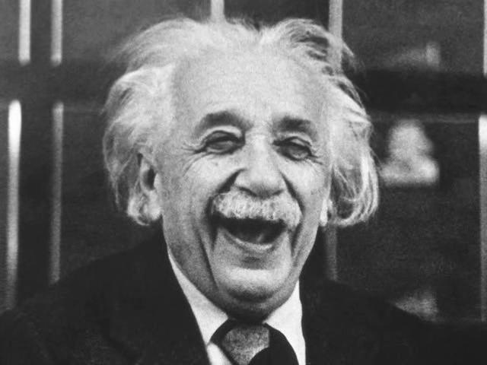
Special Relativity
Introduces spacetime
Two postulates
Laws of physics same in any non-accelerating reference frame
Speed of light is constant
Predicts length contraction, time dilation, …

Slide 5
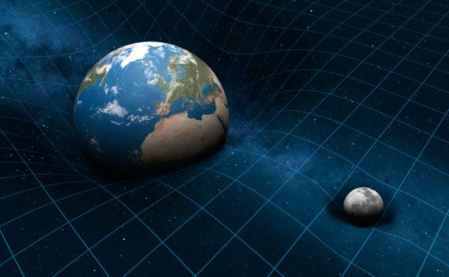
General Relativity
Gravity is caused by the warping of spacetime
The more spacetime warps the stronger the gravitational field
Many predictions to test!

Slide 6
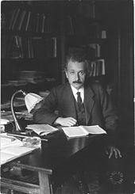
Testing General Relativity
GR made many predictions
Time delay
Light bending
Precession of the perihelion of Mercury
Gravitational Waves
and more!
Many of these are testable in our solar system
"No amount of experimentation can ever prove me right; a single experiment can prove me wrong”
– Albert Einstein

Slide 7
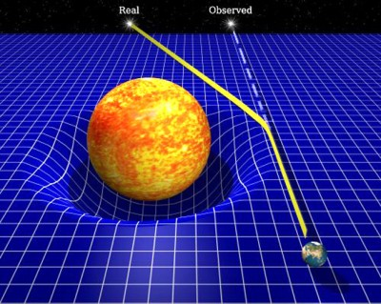
Bending of Light
Light gets bent by curved spacetime
Stars can appear to come from a different direction
First tested with Eddington’s solar eclipse experiment

Slide 8
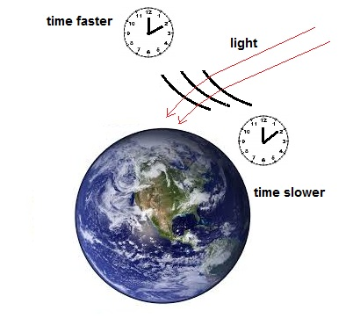
Gravitational Time Delay
Time moves slower in stronger gravitational fields
Tested by bouncing radar signals off of Mercury and Venus
Needed to make GPS satellites accurate

Slide 9
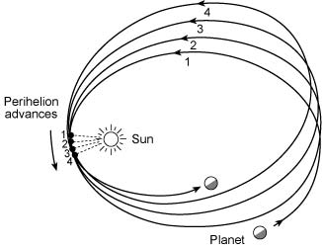
Precession of the Perihelion of Mercury
Measure point of closest approach to the sun
Observed value off from classical theoretical values by 0.012 deg/century
GR fixed this discrepancy

Slide 10
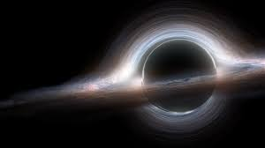
Strong Gravitational Fields
Black Holes
Form when massive star collapses
Gravity so strong light can’t escape
Neutron Stars
Collapsed core of stars
Gravitational fields 10¹¹ times stronger than on Earth

Slide 11
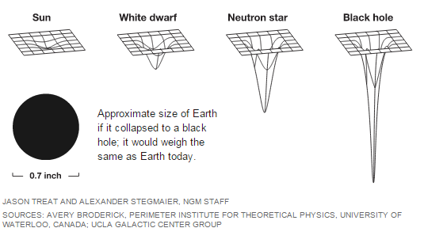

Slide 12
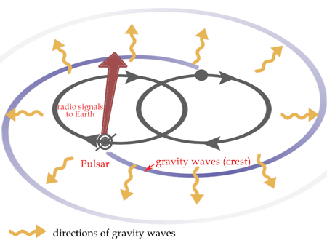
GR Outside Our Solar System
Look at the Hulse-Taylor binary pulsar
Orbits decay over time
Energy carried away by gravitational waves
1st indirect detection of GWs!

Slide 13
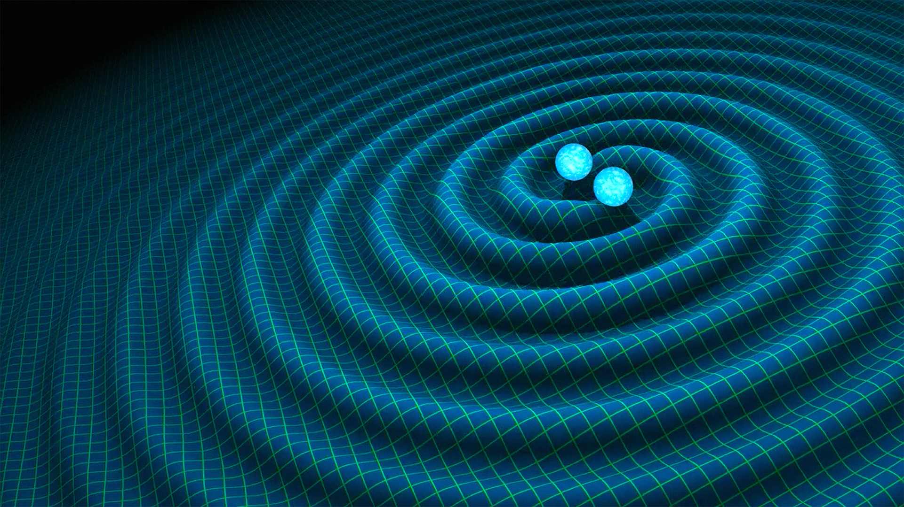
Gravitational Waves
Can propagate as ripples in spacetime
Detectable in dense binary star systems
White dwarfs
Neutron stars
Black holes

Slide 14
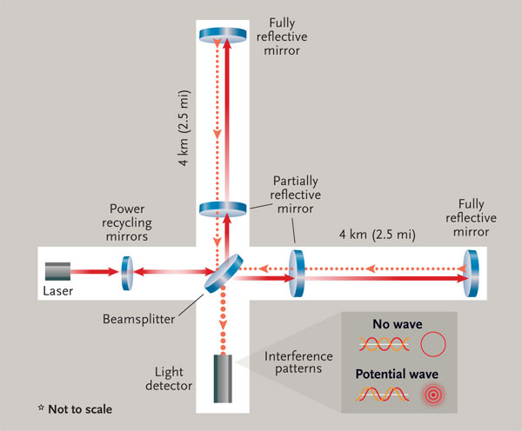
LIGO
Laser Interferometer Gravitational Wave Observatory
Beam split down two arms
If GW present the length of the arm will shrink
2 locations in Washington and Louisiana USA
More locations being planned

Slide 15
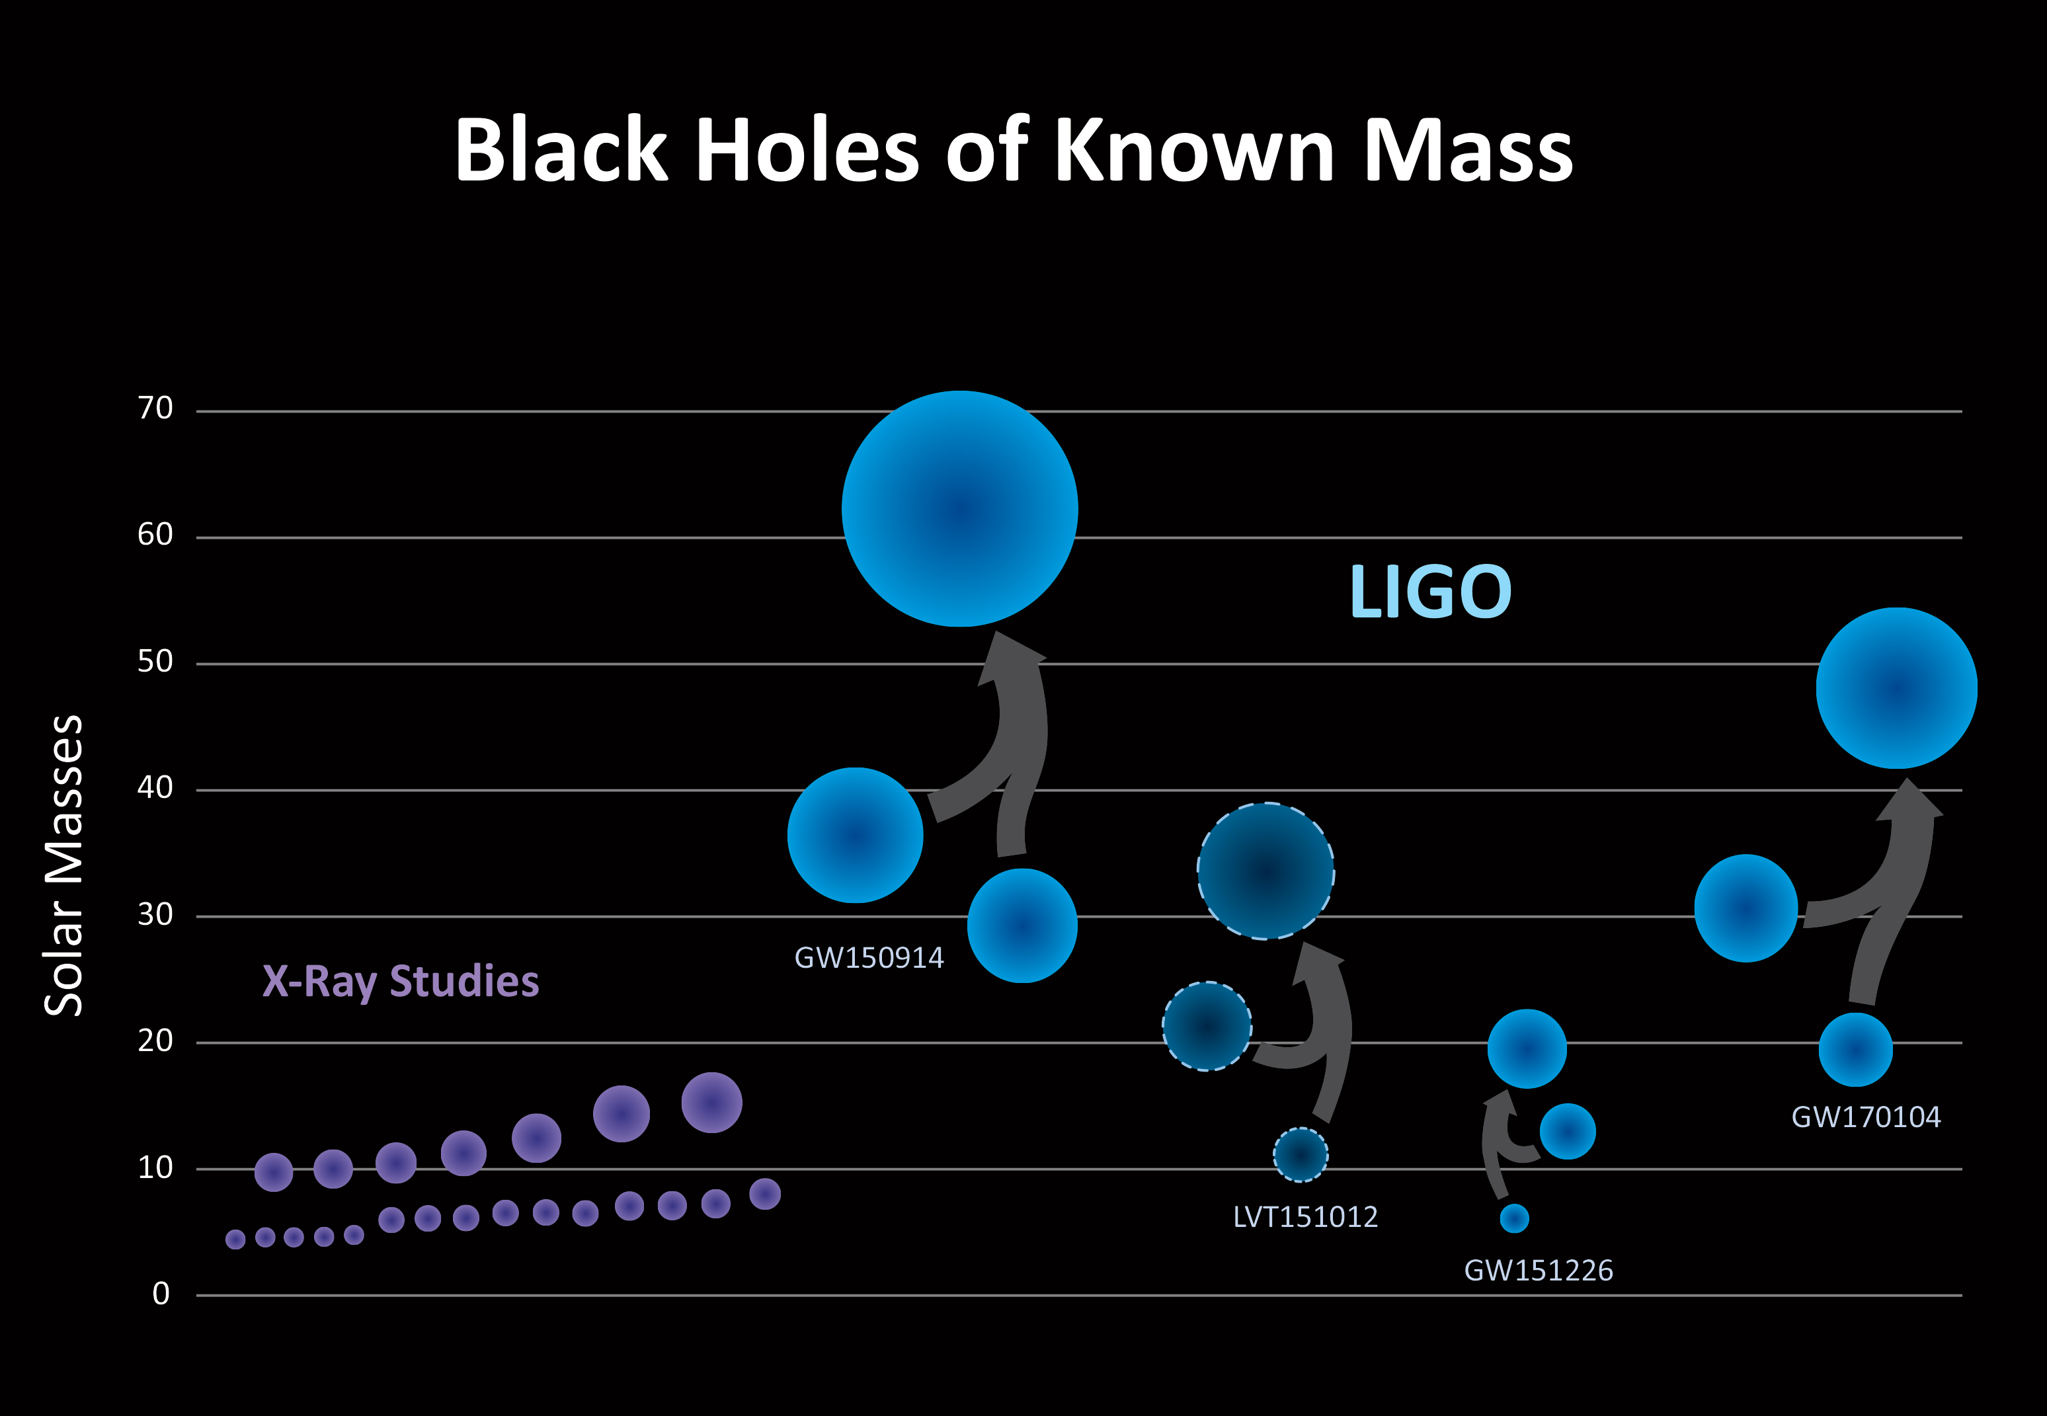
GW Detections
3 confirmed detections so far
All results of two black holes merging
Turns out the black holes are bigger than we expected

Slide 16
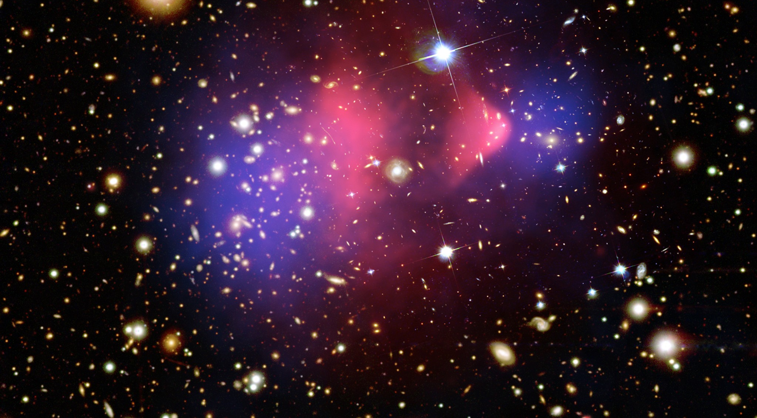
Dark Matter

Slide 17
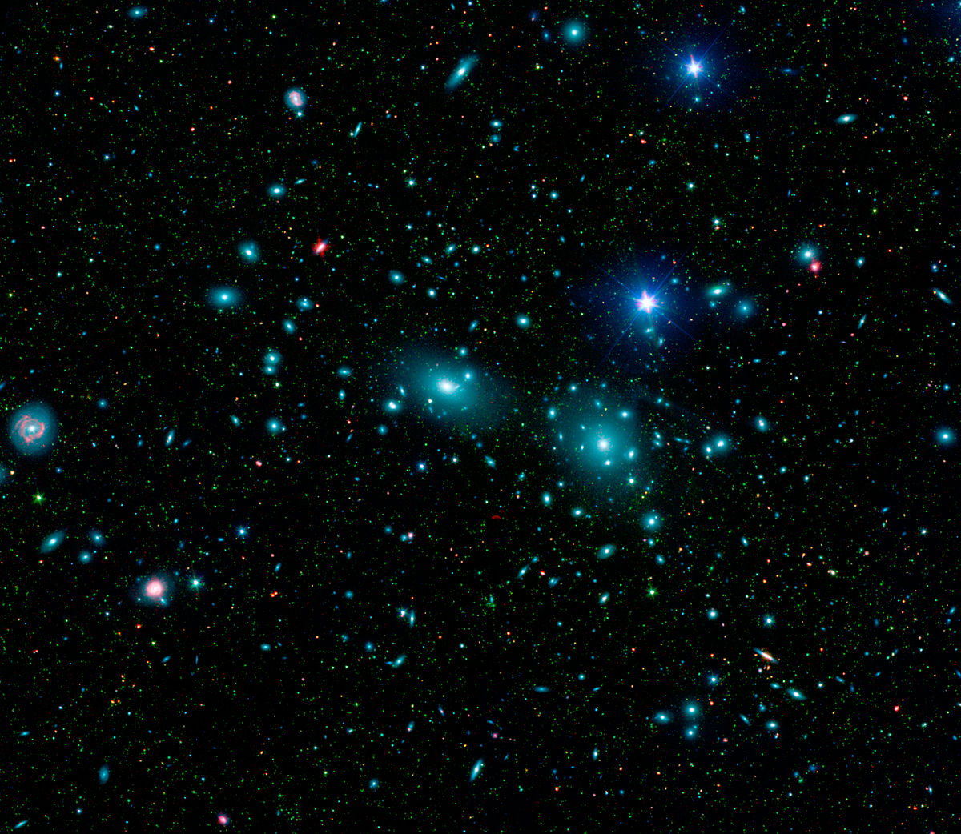
Dark Matter
“Dunkle Materie” coined by Swiss astronomer Fritz Zwicky
Coma galaxy cluster
Looks to have a mass 400 times greater than expected
Proposed that the mass came from matter we couldn’t see

Slide 18
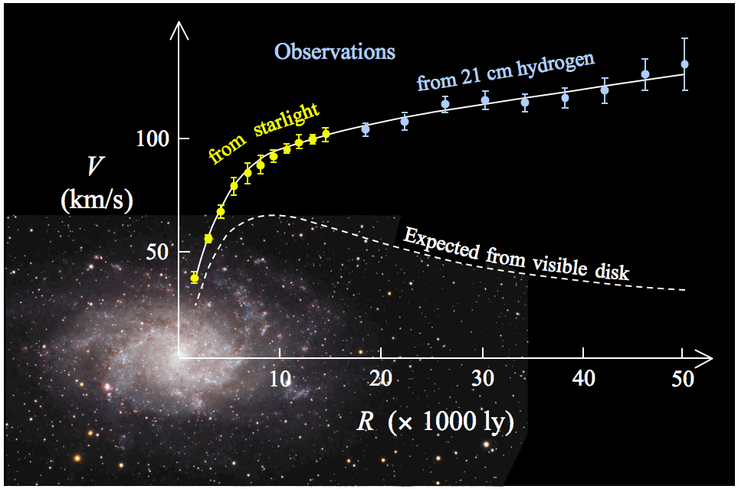
Galaxy Rotation Curves
Studied by Vera Rubin and Kent Ford
Velocity of gas is larger than expected
Could only happen if there was more matter present than observed
Around 21% of the total contents in the universe

Slide 19
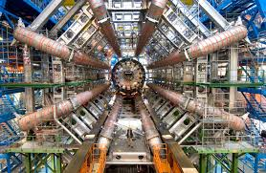
New Particles?
Weakly interacting massive particles
WIMPs
Direct Detection
detect DM particles travelling through earth
Indirect Detection
Look for particles in space
Colliders
made in the lab

Slide 20
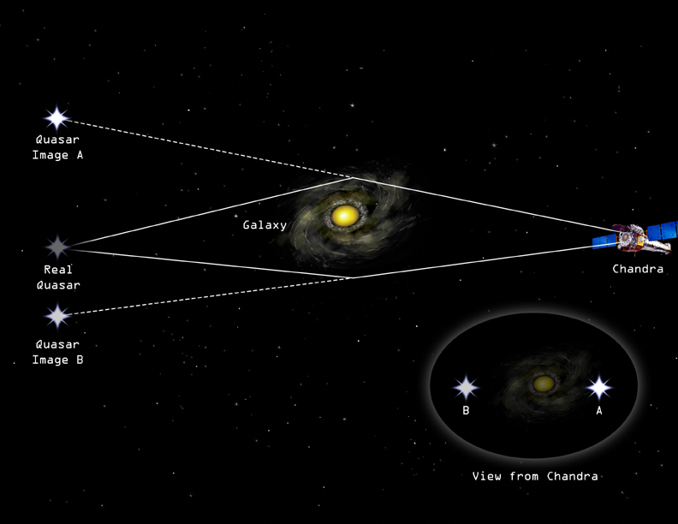
MACHOs
Massive Astrophysical Compact Halo Objects
Potentially black holes 10s times more massive than the sun
First observations of such black holes made with LIGO
Observed using gravitational lensing

Slide 21
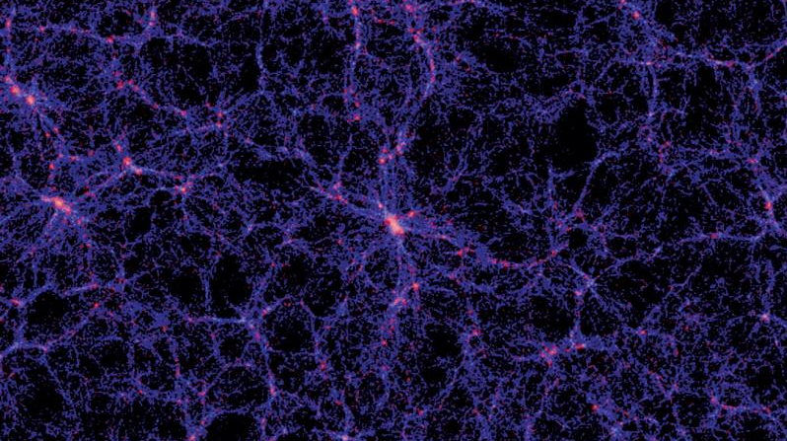
Dark Energy

Slide 22
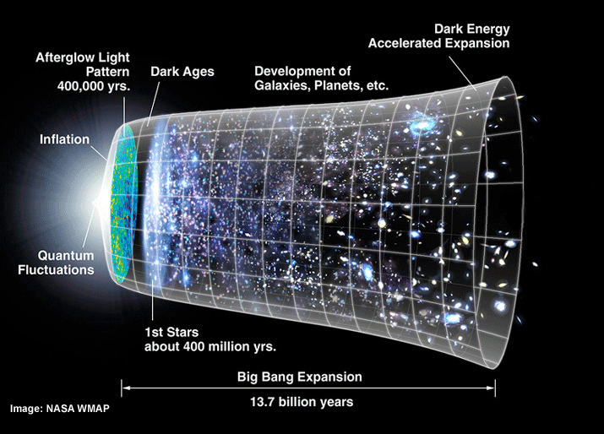
The Expanding Universe
Hubble saw that the universe was expanding by looking at the motion of galaxies
Provided solution to Olbers’s paradox
The expansion is accelerating!

Slide 23
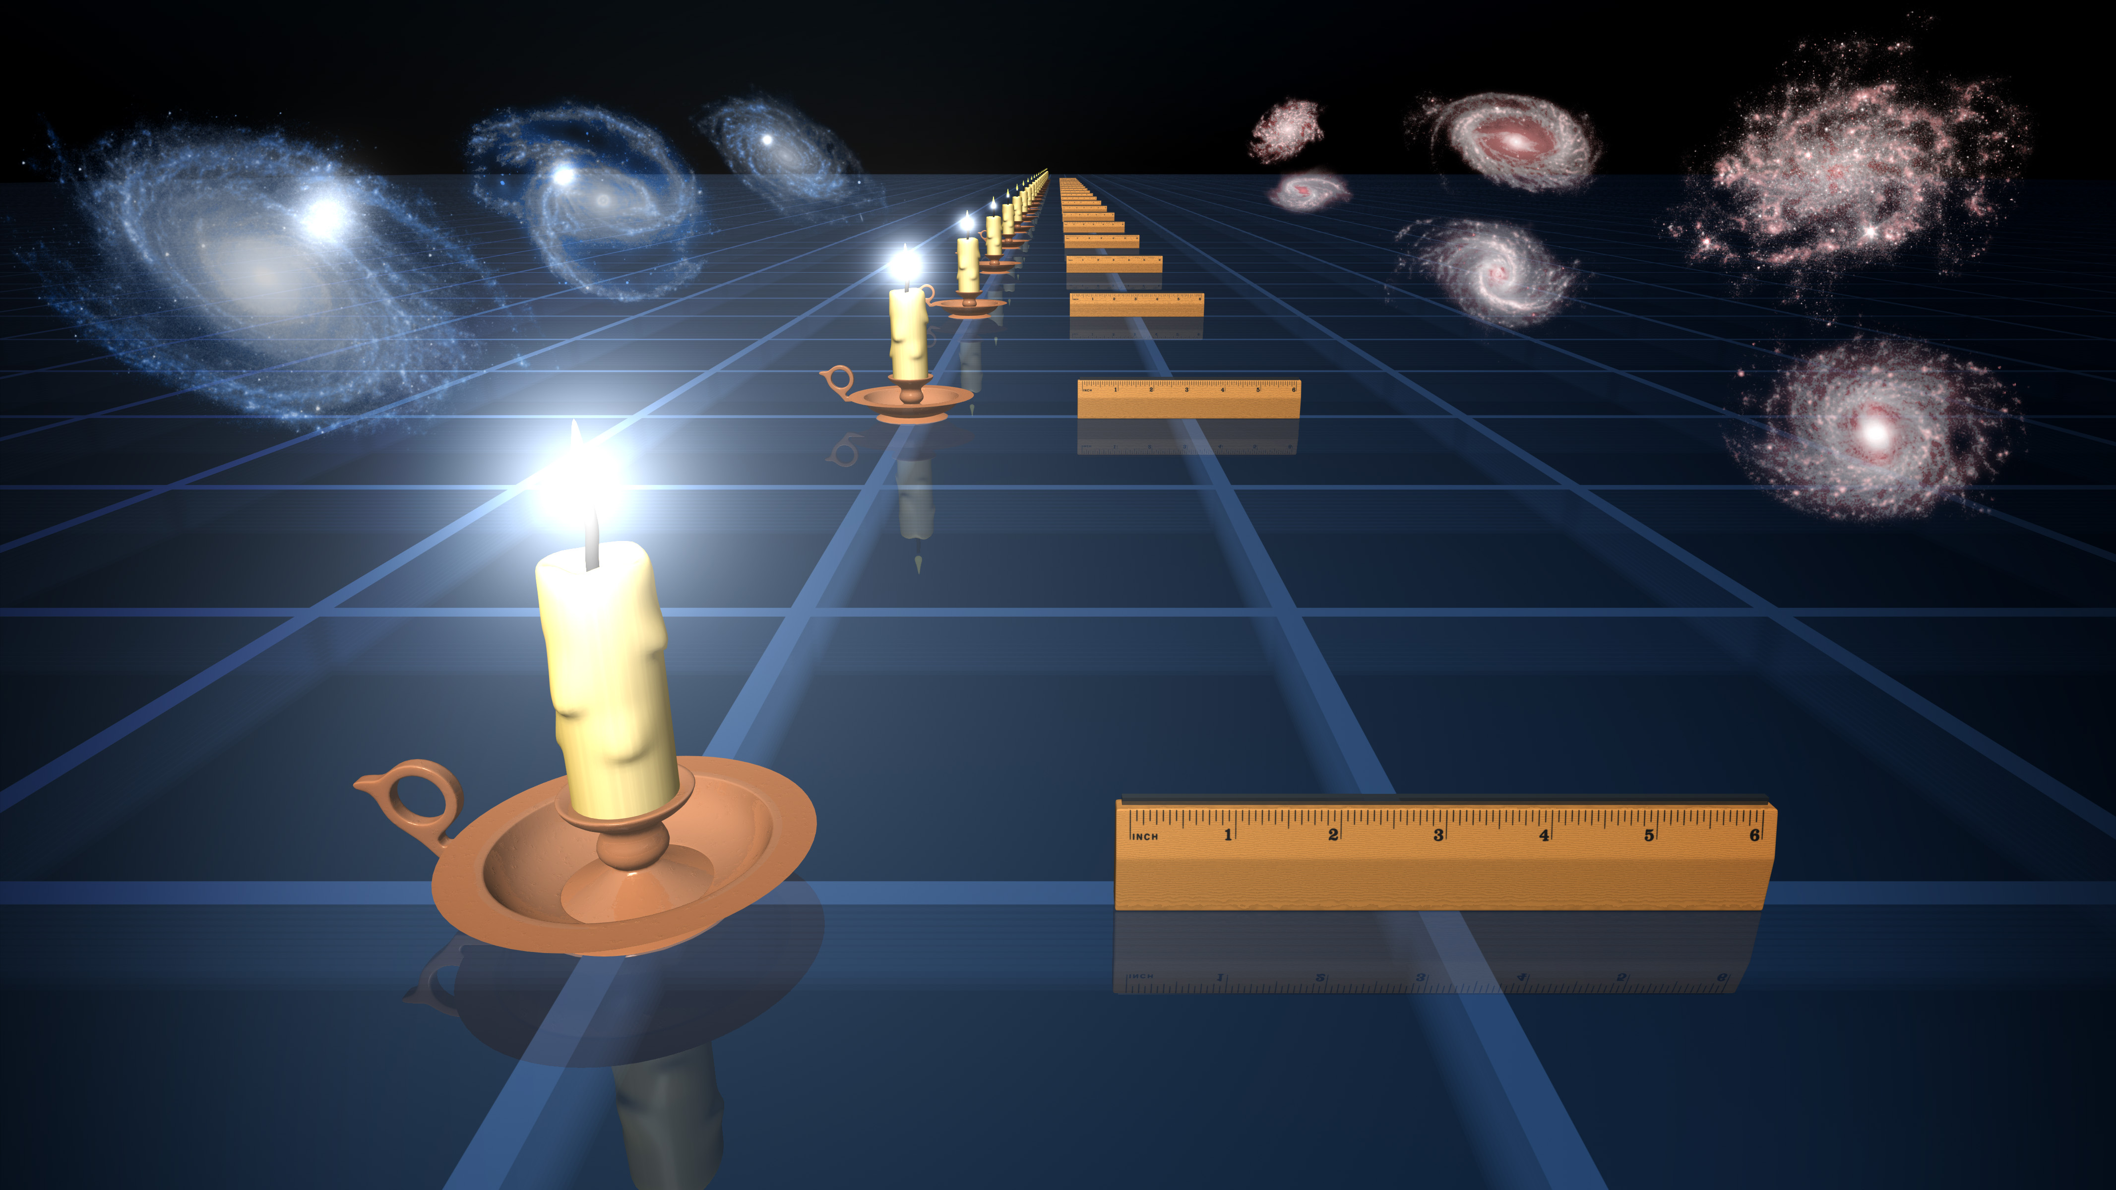
Accelerating Expansion
Use supernova as standard candles
Allows us to measure distance to distant galaxies
The expansion of the universe causes this light to be redshifted
Also use baryonic acoustic oscillations

Slide 24
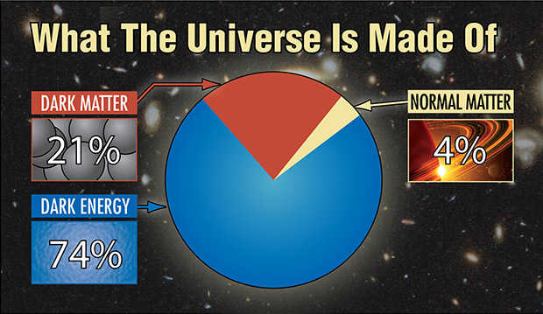

Slide 25
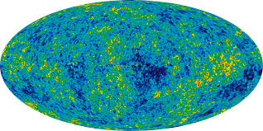
What is Dark Energy?
Cosmological Constant
Einstein’s biggest blunder
Vacuum Energy
Quantum field theory predicts it 10¹⁰⁰ too big
Maybe we need to rethink our theory of gravity

Slide 26
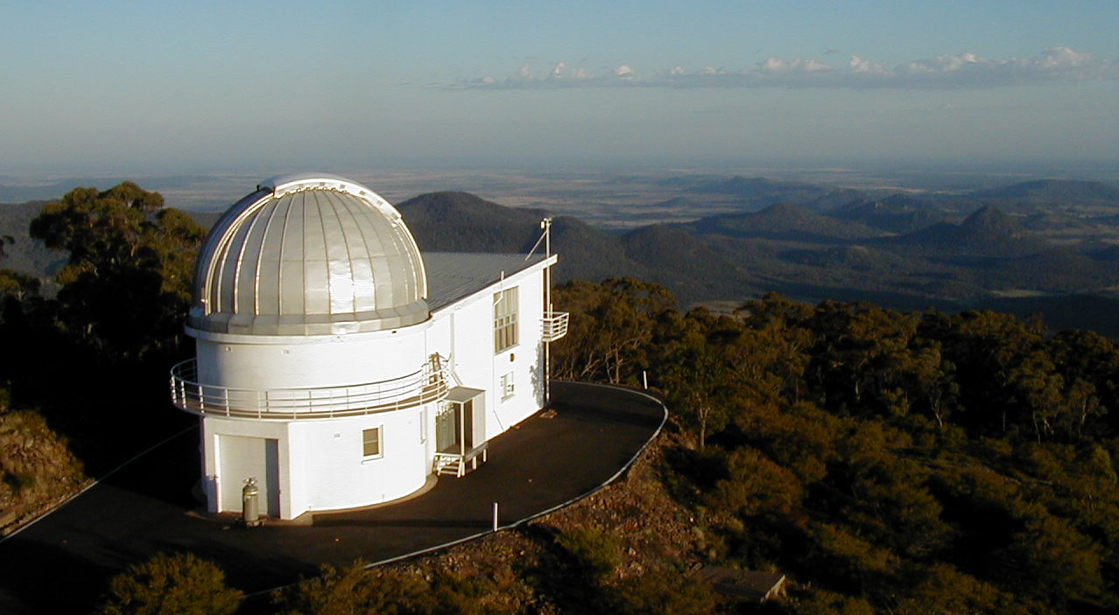
Cosmology in Australia

Slide 27
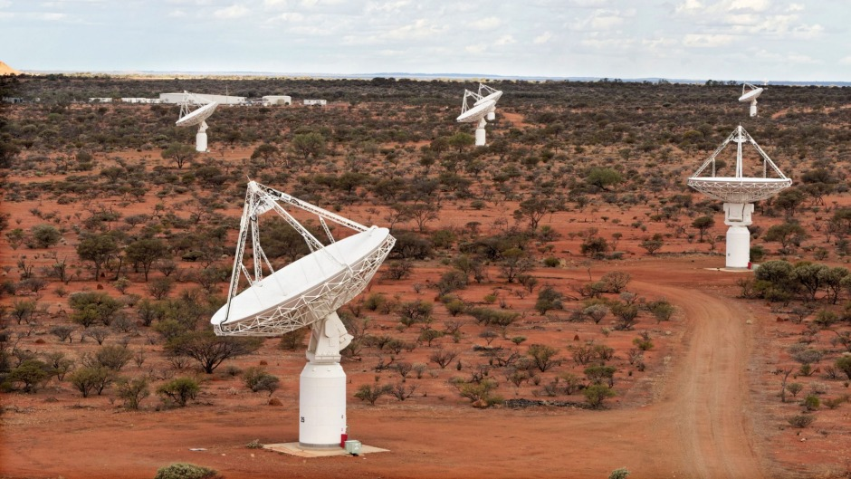
Square Kilometre Array
Located in Australia and South Africa
Uses thousands of antenna 1000s of km apart
First light in 2020
Generate 160 TB of data a second
More than 35,000 DVDs/sec!
Map billions of galaxies out the observable edge of the universe

Slide 28
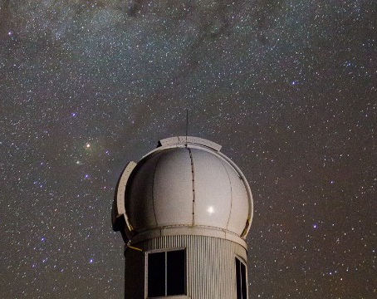
SkyMapper
1.35m wide optical telescope at Siding Springs Observatory
Images the entire southern sky multiple times
Search for supernova to study the expansion of the universe

Slide 29
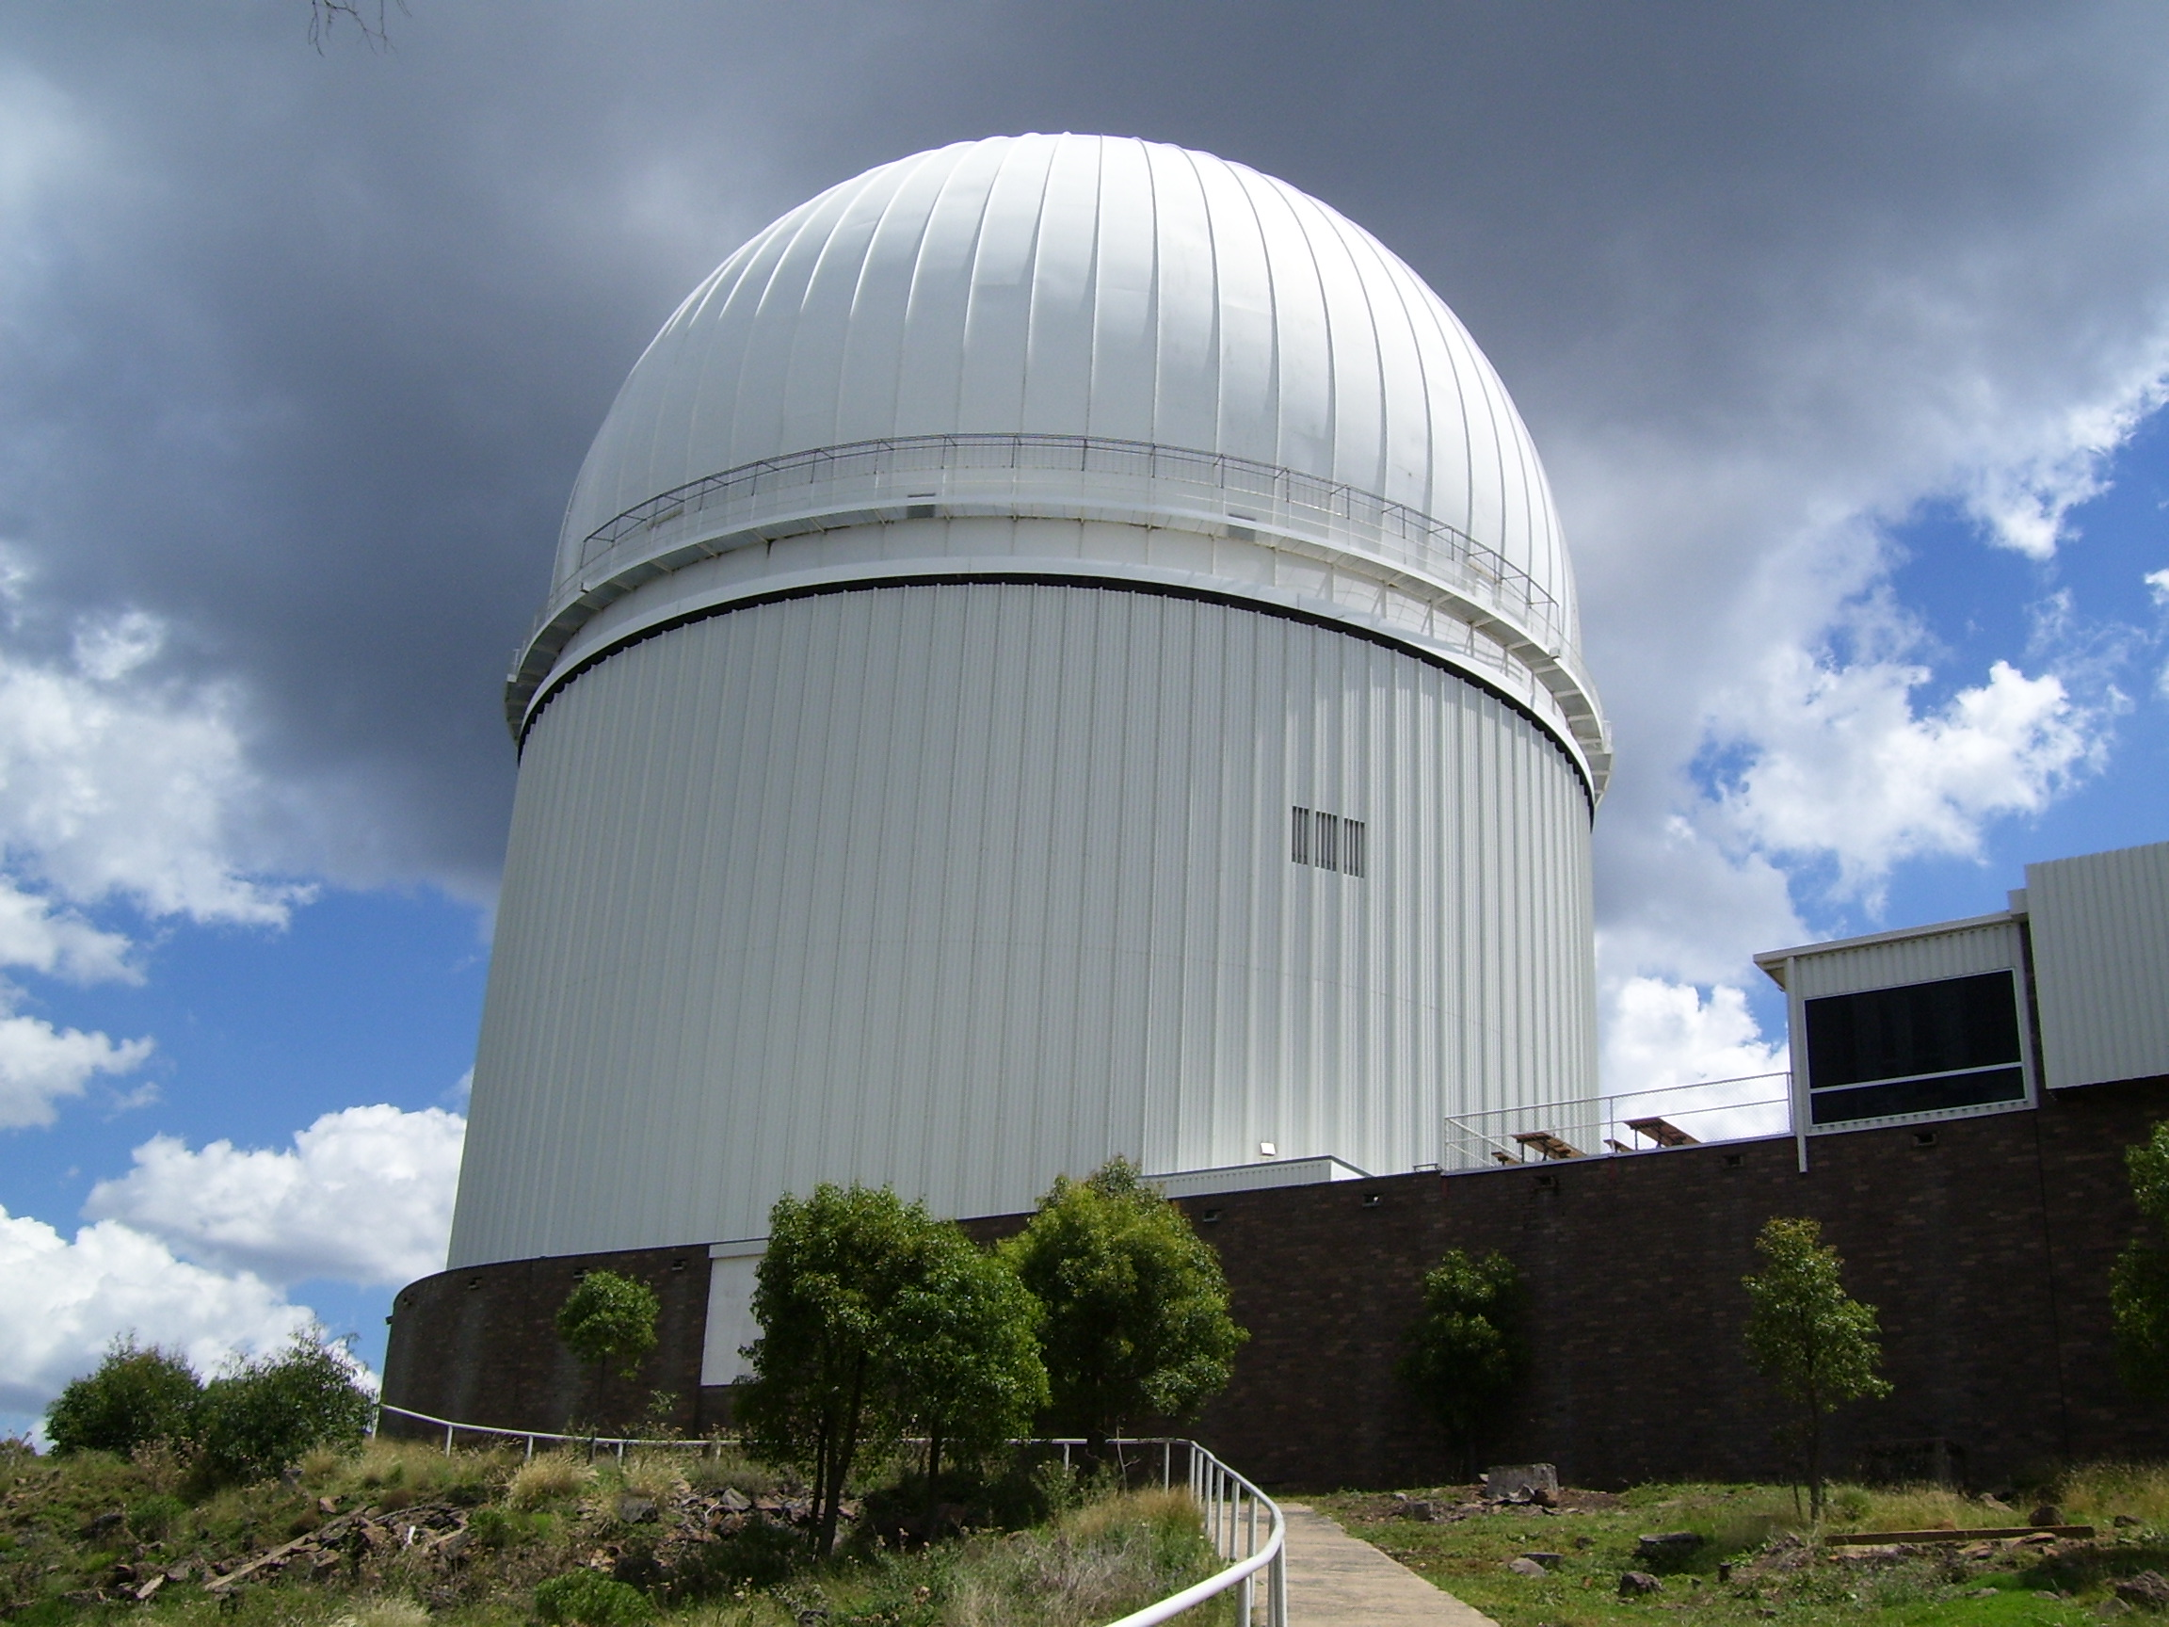
Australian Dark Energy Survey
Australian arm of the Dark Energy Survey
Uses the Anglo Australia Telescope
4m optical telescope
Measures the distances to supernova host galaxies and the mass of black holes

Slide 30
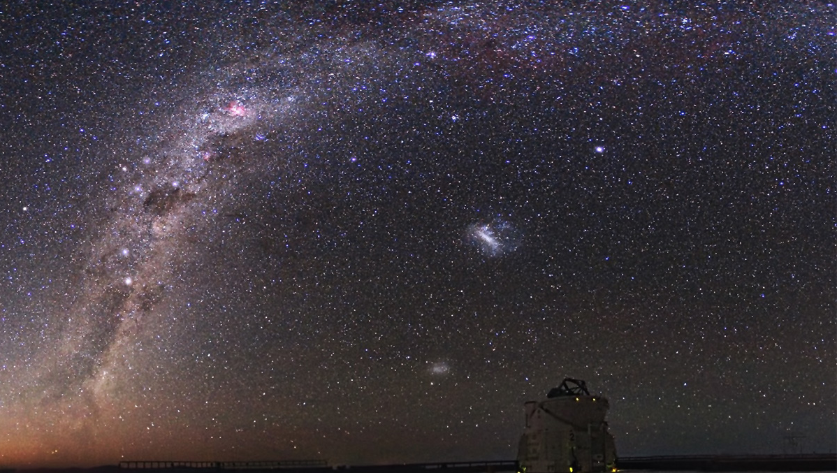
Thank you! Questions?

